Slide 1
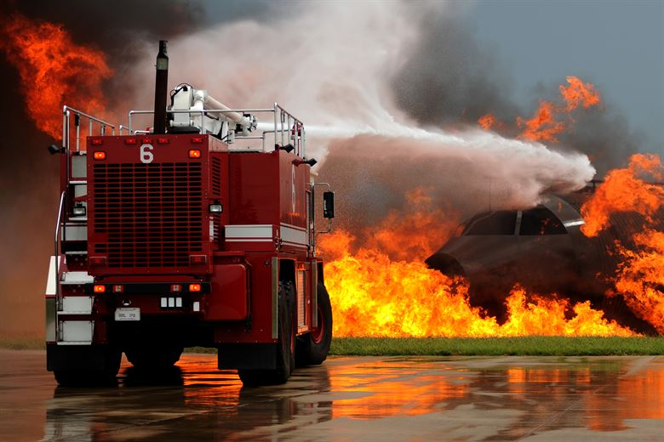
AUTONOMOUS
FIRE FIGHTING ROBOT
using
MACHINE LEARNING
T.M.CHAKRADHAR
FROM 2nd ECE

Slide 2
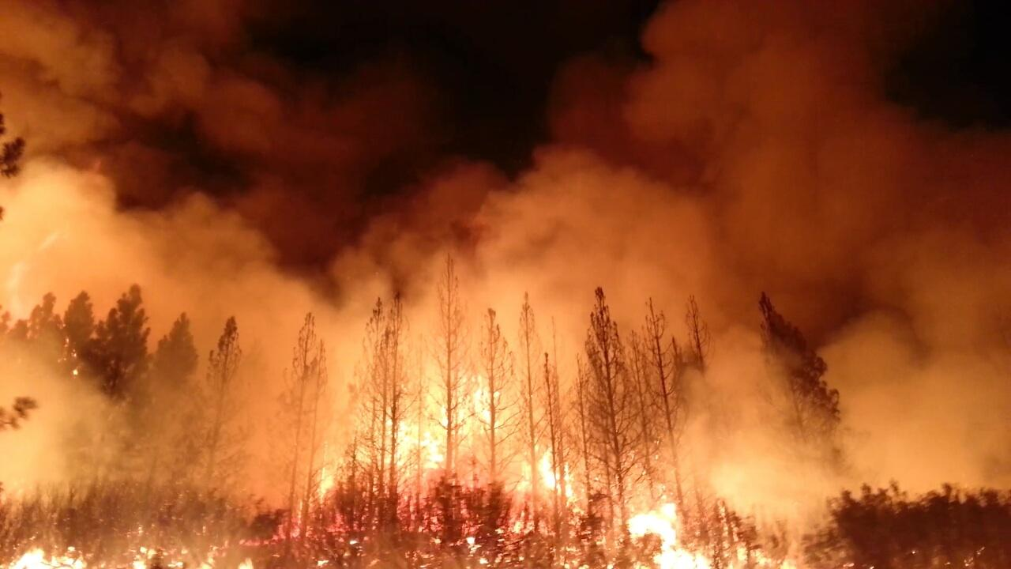
Reasons for introducing the FIRE FIGHTING ROBOTS are to control FIRE accidents
In Forest Fires and save the wildlife.
In Schools and Hospitals.
In heavy crowded places like Malls,Theatres,etc.
In Fuel industries and Manufacturing agencies etc

Slide 3
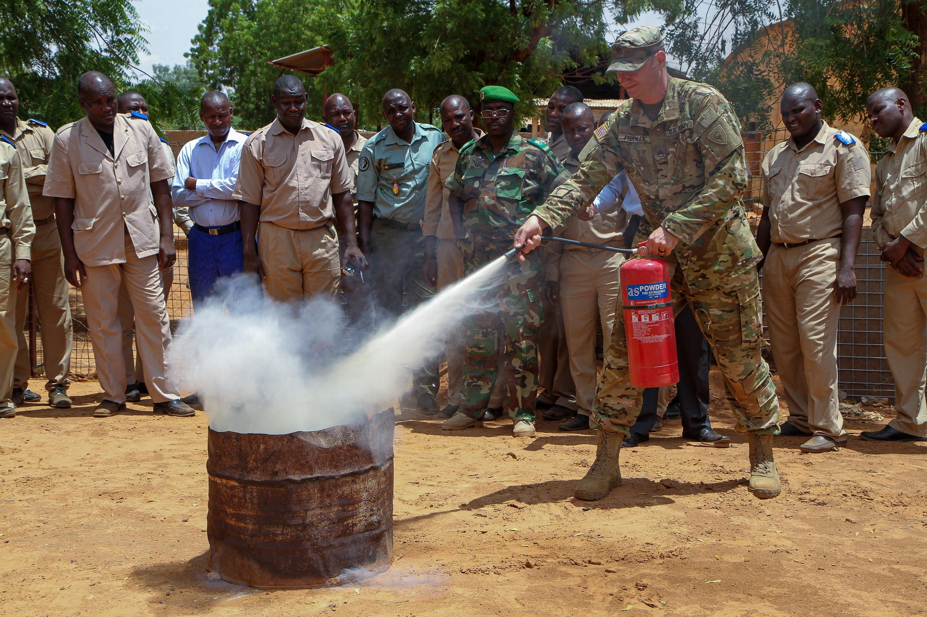
Present Methods
Fire Rescue Teams
Fire Extinguishers
Sensor based fire controlling robots

Slide 4
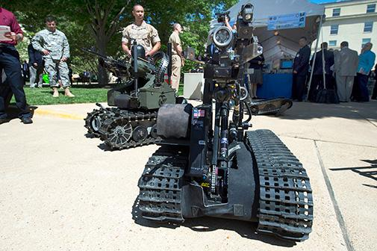
At present the world is running towards the ARTIFICIAL INTELLIGENCE
AI is playing a key-role in every sectors
Finally, My idea is to replace the sensor robots and develop them using AI
Using AI we may get the better results than using the sensors.

Slide 5

What is AI ?
What is Machine Learning ?
How does ML robot works ?
What are the tools required ?
ANY QUESTIONS……???

Slide 6


